Slide 1
Excel Project
Food Delivery Analysis

Slide 2
Data Explanation
I created the dataset by myself using Excel. It has:
6 tables (Customer, Restaurant, Driver, Delivery, Order, Market).
100 Rows.
33 Columns.

Slide 3
Business Questions to answer
What is the total revenue generated by restaurant from delivery?
What is the total delivery?
How many distinct order has been placed?
How many deliveries has each driver completed?
What is the average delivery price for each food items?
Which driver has the highest number of deliveries?
How many customers have placed orders in each food item?
What is the most common food items among restaurant?

Slide 4
Business Questions to answer
To answer the business questions, I have used
Pivot table.
AverageIfs Function
SumIfs Function
Maximum Function
Index Match
Advanced Filter - Unique Record Only
And then, I built the dashboard.

Slide 5
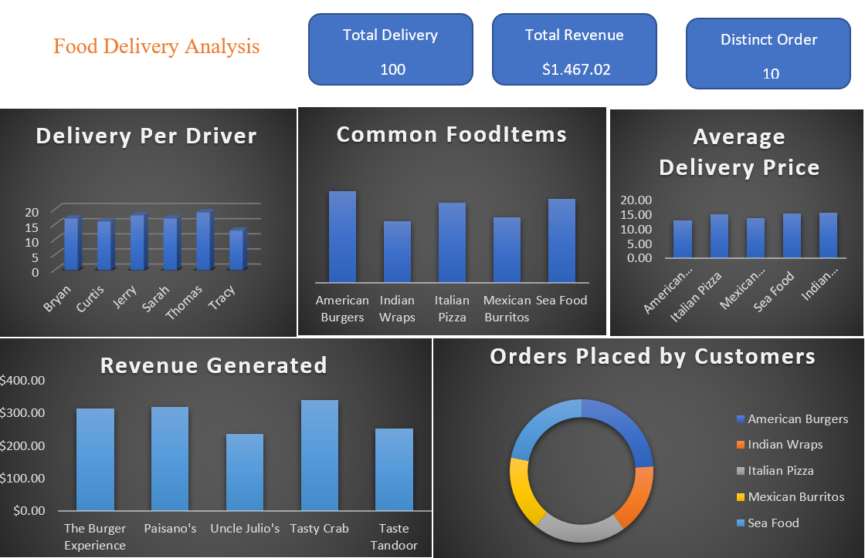

Slide 6
Findings
Overall,
We have 100 deliveries, $1,467.02 as total revenue generated from deliveries and 10 distinct order have been placed.
Thomas is the driver that has the highest number of deliveries.
American Burgers is the most common food Items among restaurant and it’s been significantly ordered by customers.
The average delivery price for food items is $14,74.

Slide 7
Thanks for Reading!
Don’t forget to comment and add more insights

